Slide 1

Analysis of Financial Statements

Slide 2
Analysis of Financial Statements
The process of critical evaluation of the financial information contained in the financial statements in order to understand and make decisions regarding the operations of the firm is called ‘Financial Statement Analysis’.
The term ‘financial analysis’ includes both ‘analysis and interpretation’.
It essentially involves regrouping and analysis of information provided by financial statements to establish relationships and throw light on the points of strengths and weaknesses of a business enterprise, which can be useful in decision-making involving comparison with other firms (cross sectional analysis) and with firms’ own performance, over a time period (time series analysis).

Slide 3
Significance of Analysis of Financial Statements
Financial analysis is useful and significant to different users in the following ways:
(a) Finance manager: Financial analysis focusses on the facts and relationships related to managerial performance, corporate efficiency, financial strengths and weaknesses and creditworthiness of the company. A finance manager must be well-equipped with the different tools of analysis to make rational decisions for the firm. The tools for analysis help in studying accounting data so as to determine the continuity of the operating policies, investment value of the business, credit ratings and testing the efficiency of operations. The techniques are equally important in the area of financial control, enabling the finance manager to make constant reviews of the actual financial operations of the firm to analyse the causes of major deviations, which may help in corrective action wherever indicated.

Slide 4
Significance of Analysis of Financial Statements
(b) Top management: The importance of financial analysis is not limited to the finance manager alone. It has a broad scope which includes top management in general and other functional managers. Management of the firm would be interested in every aspect of the financial analysis. It is their overall responsibility to see that the resources of the firm are used most efficiently and that the firm’s financial condition is sound. Financial analysis helps the management in measuring the success of the company’s operations, appraising the individual’s performance and evaluating the system of internal control.
(c) Trade payables: Trade payables, through an analysis of financial statements, appraises not only the ability of the company to meet its short-term obligations, but also judges the probability of its continued ability to meet all its financial obligations in future. Trade payables are particularly interested in the firm’s ability to meet their claims over a very short period of time. Their analysis will, therefore, evaluate the firm’s liquidity position

Slide 5
Significance of Analysis of Financial Statements
(d) Lenders: Suppliers of long-term debt are concerned with the firm’s longterm solvency and survival. They analyse the firm’s profitability over a period of time, its ability to generate cash, to be able to pay interest and repay the principal and the relationship between various sources of funds (capital structure relationships). Long-term lenders analyse the historical financial statements to assess its future solvency and profitability.
(e) Investors: Investors, who have invested their money in the firm’s shares, are interested about the firm’s earnings. As such, they concentrate on the analysis of the firm’s present and future profitability. They are also interested in the firm’s capital structure to ascertain its influences on firm’s earning and risk. They also evaluate the efficiency of the management and determine whether a change is needed or not. However, in some large companies, the shareholders’ interest is limited to decide whether to buy, sell or hold the shares.
(f) Labour unions: Labour unions analyse the financial statements to assess whether it can presently afford a wage increase and whether it can absorb a wage increase through increased productivity or by raising the prices.
(g) Others: The economists, researchers, etc., analyse the financial statements to study the present business and economic conditions. The government agencies need it for price regulations, taxation and other similar purposes.

Slide 6
Tools of Analysis of Financial Statements
The most commonly used techniques of financial analysis are as follows:
1. Comparative Statements: These are the statements showing the profitability and financial position of a firm for different periods of time in a comparative form to give an idea about the position of two or more periods. It usually applies to the two important financial statements, namely, balance sheet and statement of profit and loss prepared in a comparative form. The financial data will be comparative only when same accounting principles are used in preparing these statements. If this is not the case, the deviation in the use of accounting principles should be mentioned as a footnote. Comparative figures indicate the trend and direction of financial position and operating results. This analysis is also known as ‘horizontal analysis’.

Slide 7
Tools of Analysis of Financial Statements
2. Common Size Statements:
These are the statements which indicate the relationship of different items of a financial statement with a common item by expressing each item as a percentage of that common item. The percentage thus calculated can be easily compared with the results of corresponding percentages of the previous year or of some other firms, as the numbers are brought to common base. Such statements also allow an analyst to compare the operating and financing characteristics of two companies of different sizes in the same industry. Thus, common size statements are useful, both, in intra-firm comparisons over different years and also in making inter-firm comparisons for the same year or for several years. This analysis is also known as ‘Vertical analysis’.

Slide 8
Tools of Analysis of Financial Statements
3. Trend Analysis:
It is a technique of studying the operational results and financial position over a series of years. Using the previous years’ data of a business enterprise, trend analysis can be done to observe the percentage changes over time in the selected data. The trend percentage is the percentage relationship, in which each item of different years bear to the same item in the base year. Trend analysis is important because, with its long run view, it may point to basic changes in the nature of the business. By looking at a trend in a particular ratio, one may find whether the ratio is falling, rising or remaining relatively constant. From this observation, a problem is detected or the sign of good or poor management is detected.

Slide 9
Tools of Analysis of Financial Statements
4. Ratio Analysis: It describes the significant relationship which exists between various items of a balance sheet and a statement of profit and loss of a firm. As a technique of financial analysis, accounting ratios measure the comparative significance of the individual items of the income and position statements. It is possible to assess the profitability, solvency and efficiency of an enterprise through the technique of ratio analysis.
5. Cash Flow Analysis: It refers to the analysis of actual movement of cash into and out of an organisation. The flow of cash into the business is called as cash inflow or positive cash flow and the flow of cash out of the firm is called as cash outflow or a negative cash flow. The difference between the inflow and outflow of cash is the net cash flow. Cash flow statement is prepared to project the manner in which the cash has been received and has been utilised during an accounting year as it shows the sources of cash receipts and also the purposes for which payments are made. Thus, it summarises the causes for the changes in cash position of a business enterprise between dates of two balance sheets.

Slide 10
Ratio Analysis

Slide 11
Meaning of Accounting Ratios
A RATIO is a mathematical number calculated as a reference to relationship of two or more numbers and can be expressed as a fraction, proportion, percentage and a number of times.
When the number is calculated by referring to two accounting numbers derived from the financial statements, it is termed as accounting ratio.
Accounting ratios exhibit relationship between accounting numbers extracted from financial statements.

Slide 12
Objectives of Ratio Analysis
1. To know the areas of the business which need more attention;
2. To know about the potential areas which can be improved with the effort in the desired direction;
3. To provide a deeper analysis of the profitability, liquidity, solvency and efficiency levels in the business;
4. To provide information for making cross-sectional analysis by comparing the performance with the best industry standards;
5. To provide information derived from financial statements useful for making projections and estimates for the future.

Slide 13
Advantages of Ratio Analysis
1. Helps to understand efficacy of decisions
2. Simplify complex figures and establish relationships
3. Helpful in comparative analysis
4. Identification of problem areas
5. Enables SWOT analysis
6. Various comparisons

Slide 14
Limitations of Ratio Analysis
The Limitations Of The Ratios Analysis Are:
Means and not the End
Lack of ability to resolve problems
Lack of standardised definitions
Lack of universally accepted standard levels
Ratios based on unrelated figures

Slide 15
Limitations of Ratio Analysis
The limitations of ratio analysis which arise primarily from the nature of financial statements:
Limitations of Accounting Data
Ignores Price-level Changes
Ignore Qualitative or Non-monetary Aspects
Variations in Accounting Practices
Forecasting

Slide 16
Types of Ratios
There is a two way classification of ratios:
(1) traditional classification, and
(2) functional classification.
The traditional classification has been on the basis of financial statements to which the determinants of ratios belong. On this basis the ratios are classified as follows:
Statement of Profit and Loss Ratios
Balance Sheet Ratios
Composite Ratios

Slide 17
Types of Ratios
Functional classification based on the purpose for which a ratio is computed, is the most commonly used classification which is as follows:
Liquidity Ratios
Solvency Ratios
Activity (or Turnover) Ratios
Profitability Ratios

Slide 18
Types of Ratios
1. Liquidity Ratios: To meet its commitments, business needs liquid funds. The ability of the business to pay the amount due to stakeholders as and when it is due is known as liquidity, and the ratios calculated to measure it are known as ‘Liquidity Ratios’. These are essentially short-term in nature.
2. Solvency Ratios: Solvency of business is determined by its ability to meet its contractual obligations towards stakeholders, particularly towards external stakeholders, and the ratios calculated to measure solvency position are known as ‘Solvency Ratios’. These are essentially long-term in nature.
3. Activity (or Turnover) Ratios: This refers to the ratios that are calculated for measuring the efficiency of operations of business based on effective utilization of resources. Hence, these are also known as ‘Efficiency Ratios’.
4. Profitability Ratios: It refers to the analysis of profits in relation to revenue from operations or funds (or assets) employed in the business and the ratios calculated to meet this objective are known as ‘Profitability Ratios’.

Slide 19
Liquidity Ratios
Liquidity ratios are calculated to measure the short-term solvency of the business, i.e. the firm’s ability to meet its current obligations.
Current Ratio
Current assets incl. current investments, inventories, trade receivables (debtors and bills receivables), cash and cash equivalents, short-term loans and advances and other current assets such as prepaid expenses, advance tax and accrued income, etc.
Current liabilities include short-term borrowings, trade payables (creditors and bills payables), other current liabilities and short-term provisions.

Slide 20
Current Ratio
It reflects the working capital situation and indicates the ability of a company to pay its short-term creditors from the realization of its current assets.
It provides a measure of degree to which current assets cover current liabilities. The excess of current assets over current liabilities provides a measure of safety margin available against uncertainty in realization of current assets and flow of funds.
The ratio should be reasonable. It should neither be very high or very low. Both the situations have their inherent disadvantages.
A very high current ratio implies heavy investment in current assets which is not a good sign as it reflects under utilization or improper utilization of resources.
A low ratio endangers the business and puts it at risk of facing a situation where it will not be able to pay its short-term debt on time. If this problem persists, it may affect firms credit worthiness adversely.
Normally, it is safe to have this ratio within the range of 2:1.

Slide 21
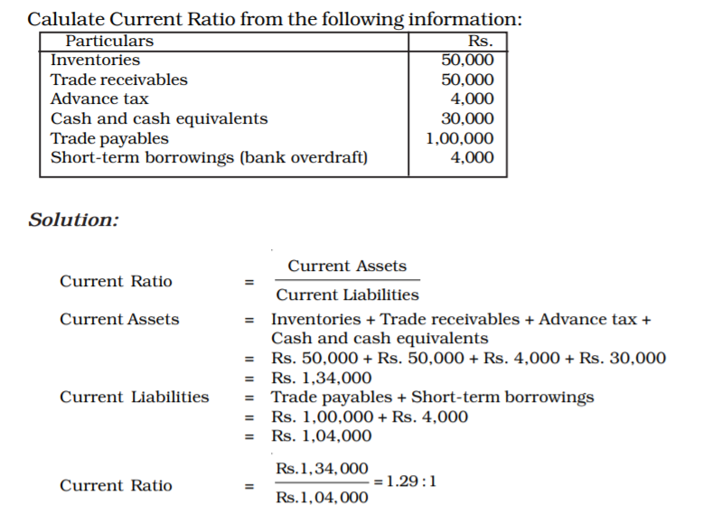
Question:

Slide 22
Liquidity Ratios
2. Quick Ratio or liquid ratio or acid test ratio
Quick assets are defined as those assets which are quickly convertible into cash.
Quick Assets = Current Assets – Inventory – Prepaid Expense
While calculating quick assets we exclude the inventories at the end and other current assets such as prepaid expenses, advance tax, etc., from the current assets.
It is calculated to serve as a supplementary check on liquidity position of the business and is therefore, also known as ‘Acid-Test Ratio’.
It is generally considered to be a more accurate assessment of a company’s financial health (than the current ratio) as it excludes stock; thus, it reduces the risk of relying on a ratio that may include slow moving or redundant stock.
An ideal ratio is 1. In manufacturing, figures between 0.7 and 1.1 are seen as acceptable, and for wholesalers, 0.7 to 1.0. Construction should operate at between 0.6 and 1.0.

Slide 23
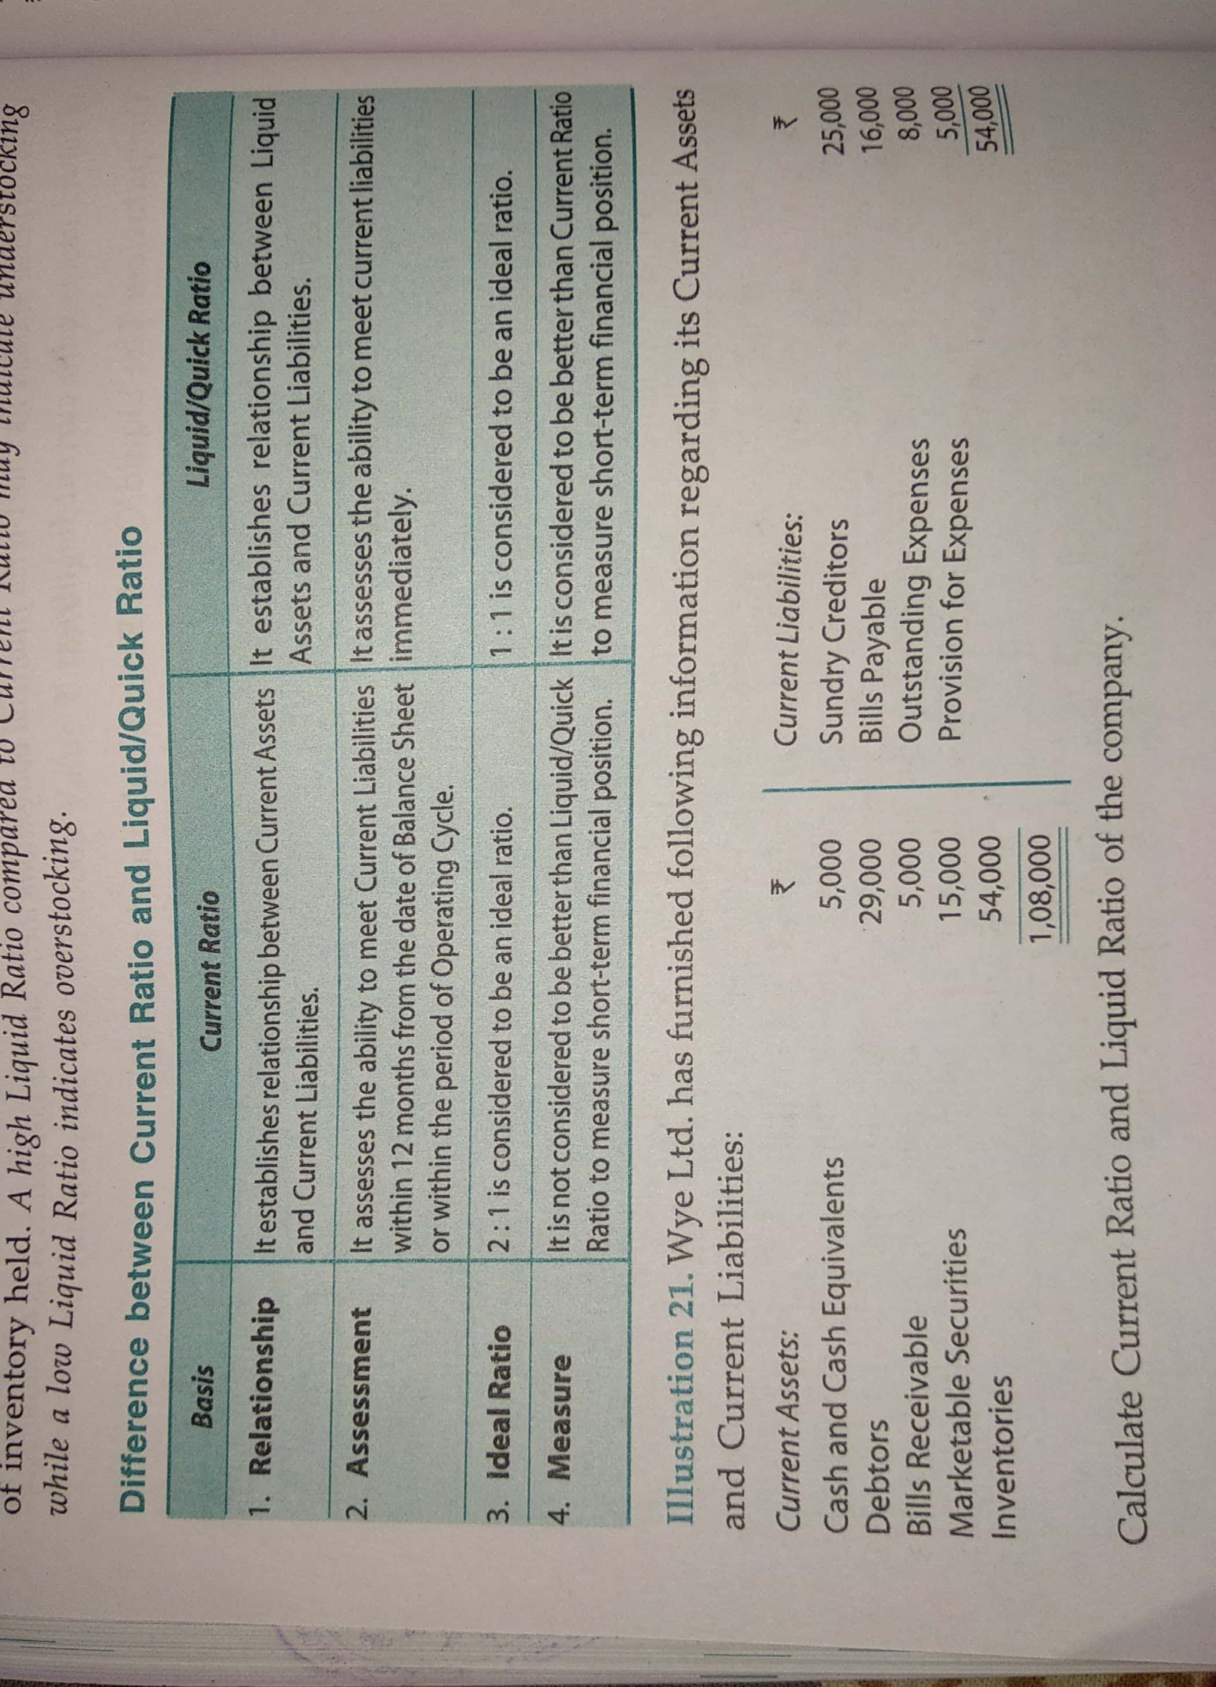

Slide 24
Question:
Calculate ‘Liquidity Ratio’ from the following information:
Current liabilities = Rs. 50,000
Current assets = Rs. 80,000
Inventories = Rs. 20,000
Advance tax = Rs. 5,000
Prepaid expenses = Rs. 5,000

Slide 25
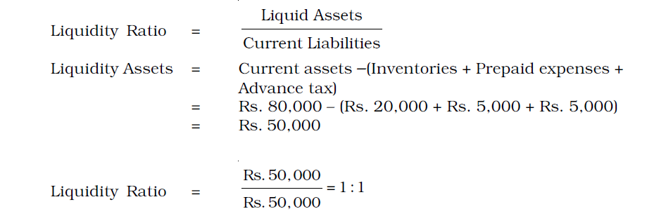
Solution:

Slide 26
Question:
Current Ratio is 2.5; Working Capital is Rs. 60,000. Calculate the amount of current assets and current liabilities.

Slide 27

Solution:

Slide 28
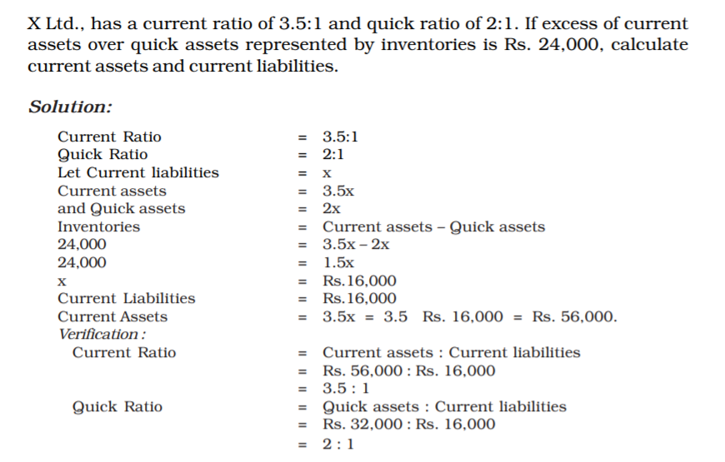
Question:

Slide 29
Solution:

Slide 30
Solvency Ratios (long term solvency )
Solvency ratios are calculated to determine the ability of the business to service its debt in the long run.
The following ratios are normally computed for evaluating solvency of the business.
1. Debt-Equity Ratio;
2. Debt to Capital Employed Ratio;
3. Proprietary Ratio;
4. Total Assets to Debt Ratio;
5. Interest Coverage Ratio.

Slide 31

Solvency Ratios
Debt-Equity Ratio
where:
Shareholders’ Funds (Equity) = Share capital + Reserves and Surplus + Money received against share warrants
Share Capital = Equity share capital + Preference share capital
or
Shareholders’ Funds (Equity) = Non-current assets + Working capital – Noncurrent liabilities
Working Capital = Current Assets – Current Liabilities

Slide 32
Debt-Equity Ratio
The D/E ratio indicates relative proportions of debt and equity in financing the assets of a firm and the extent to which it depends upon debt capital for its existence. In other words, it reveals whether the firm is highly leveraged or not, that is, whether it has the benefit of trading on equity. It also indicates the margin of safety to the creditors — the amount of risk that creditors face in getting back their due money. The higher the ratio, the greater will be the risk to the creditors; therefore, this indicates too much dependence of the firm on debt capital. The ideal ratio is taken as 2:1.

Slide 33
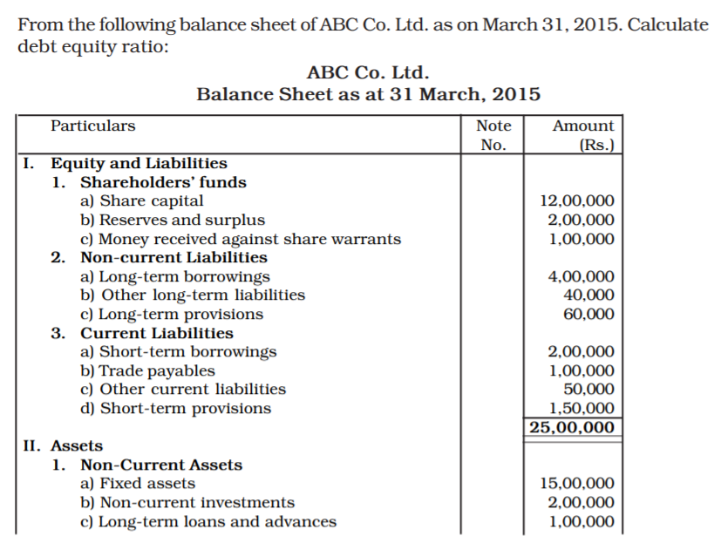
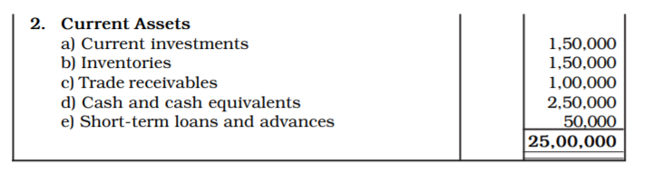
Question:

Slide 34
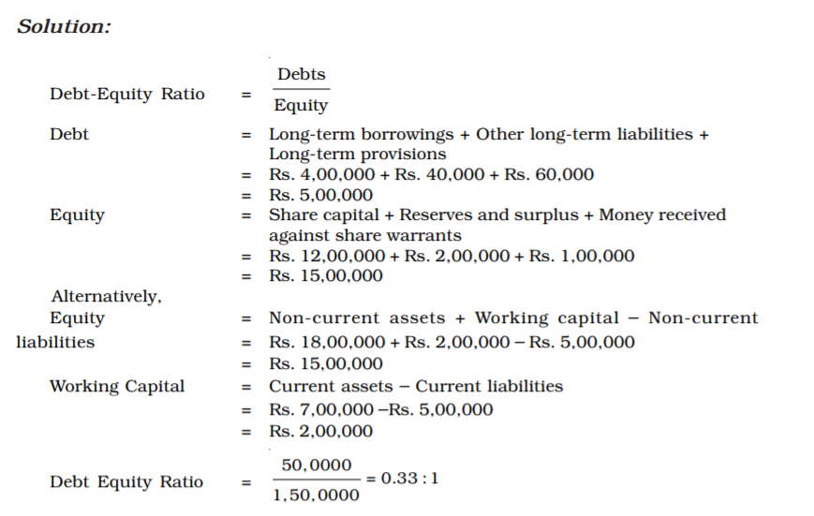

Slide 35
Solvency Ratios
2. Debt to Capital Employed Ratio
The Debt to capital employed ratio refers to the ratio of long-term debt to the total of external and internal funds (capital employed or net assets). It is computed as follows:
Debt to Capital Employed Ratio = Long-term Debt/Capital Employed (or Net Assets)
Where,
Capital employed = long-term debt + shareholders’ funds.
Alternatively, it may be taken as net assets which are equal to the total assets – current liabilities
➔Like debt-equity ratio, it shows proportion of long-term debts in capital employed. Low ratio provides security to lenders and high ratio helps management in trading on equity. In the above case, the debt to Capital Employed ratio is less than half which indicates reasonable funding by debt and adequate security of debt.

Slide 36
Solvency Ratios
3. Proprietary Ratio
Proprietary Ratio = Shareholders Funds/Capital employed (or net assets)
➔This ratio determines if the total liabilities of a business (both secured and unsecured) are too high, indicating a possible over-dependency on outside sources for long-term financial support. By comparing shareholders’ funds with total assets, we can produce a confidence factor for unsecured creditors to the business. As a general rule, the higher the result the better it is.
4. Total Assets to Debt Ratio
Total assets to Debt Ratio = Total assets/Long-term debts
➔This ratio primarily indicates the rate of external funds in financing the assets and the extent of coverage of their debts are covered by assets

Slide 37
Solvency Ratios
5. Interest Coverage Ratio
Interest Coverage Ratio= Net Profit before Interest & Tax/ Interest on long-term debts
➔It reveals the number of times interest on long-term debts is covered by the profits available for interest. A higher ratio ensures safety of interest on debts.

Slide 38
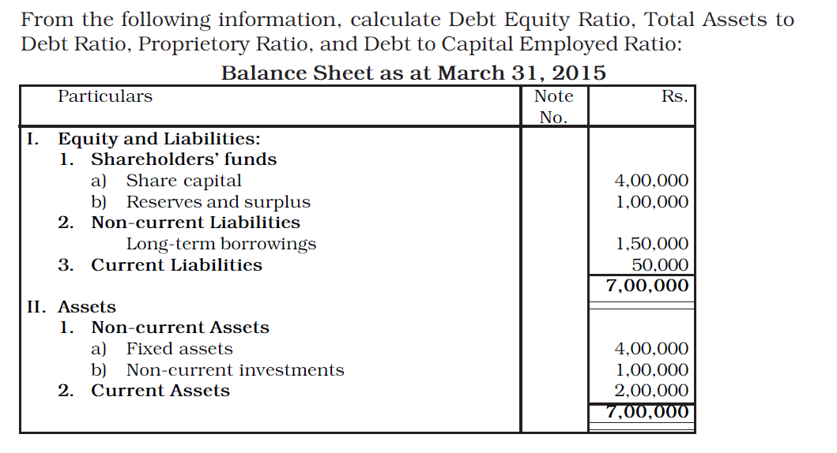
Question:

Slide 39
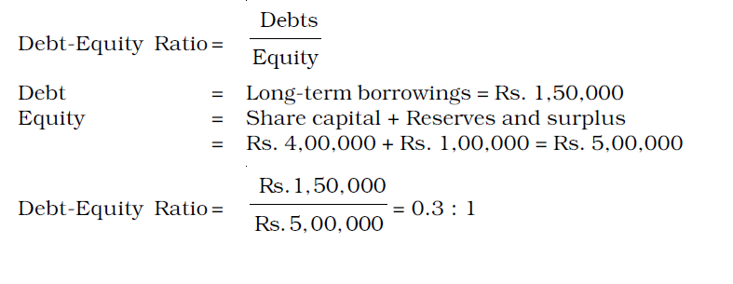
Solution:

Slide 40
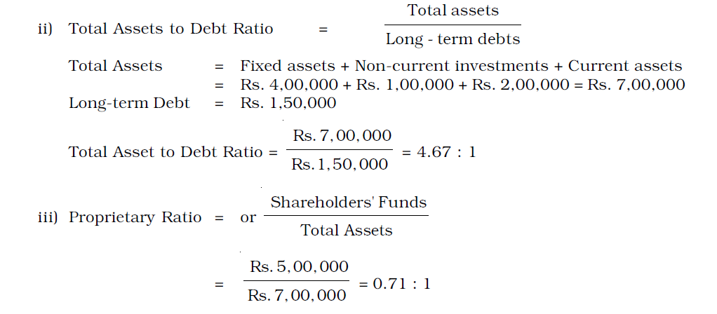
Solution: (Continued)

Slide 41
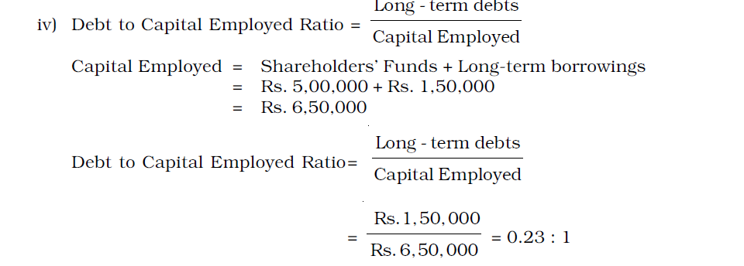
Solution: (Continued)

Slide 42
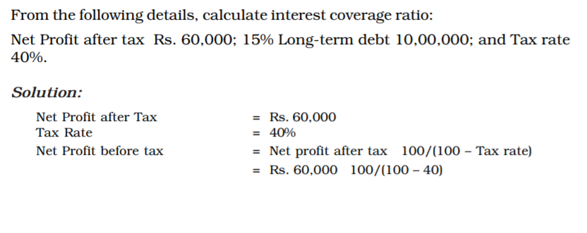
Question:

Slide 43
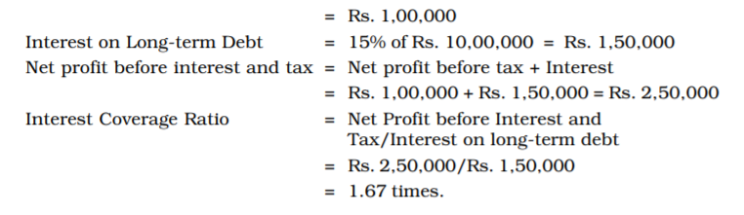

Slide 44
Activity (or Turnover) Ratio
These ratios indicate the speed at which, activities of the business are being performed.
The activity ratios express the number of times assets employed, or, for that matter, any constituent of assets, is turned into sales during an accounting period.
The important activity ratios calculated under this category are:
1. Inventory Turnover;
2. Trade receivable Turnover;
3. Trade payable Turnover;
4. Investment (Net assets) Turnover
5. Fixed assets Turnover; and
6. Working capital Turnover.

Slide 45
Activity (or Turnover) Ratio
Inventory Turnover Ratio = Cost of Revenue from Operations / Average Inventory
➔It determines the number of times a company converts its stock into sales during the year. While examining this ratio, it should be kept in mind that different companies will have varying levels of stock turnover depending on the industry they operate in. Low figures are generally poor as they indicate excessively poor moving stocks.

Slide 46
Activity (or Turnover) Ratio
Trade Receivable Turnover ratio = Net Credit Revenue from Operations/Average Trade Receivable
Where, Average Trade Receivable = (Opening Debtors and Bills Receivable + Closing Debtors and Bills Receivable)/2
➔The liquidity position of the firm depends upon the speed with which trade receivables are realized. This ratio indicates the number of times the receivables are turned over and converted into cash in an accounting period. Higher turnover means speedy collection from trade receivable. This ratio also helps in working out the average collection period. The ratio is calculated by dividing the days or months in a year by trade receivables turnover ratio.

Slide 47
Activity (or Turnover) Ratio
Trade Payables Turnover ratio = Net Credit purchases/ Average trade payable
Where,
Average Trade Payable = (Opening Creditors and Bills Payable + Closing Creditors and Bills Payable)/2
➔It reveals average payment period. Lower ratio means credit allowed by the supplier is for a long period or it may reflect delayed payment to suppliers which is not a very good policy as it may affect the reputation of the business. The average period of payment can be worked out by days/months in a year by the Trade Payable Turnover Ratio.
Average Payment Period = No. of days or month in a year/ Trade Payables Turnover Ratio

Slide 48

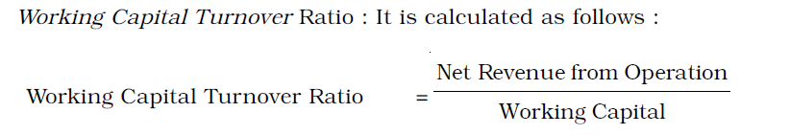
Activity (or Turnover) Ratio
Net Assets or Capital Employed Turnover Ratio
Capital employed turnover ratio which studies turnover of capital employed (or Net Assets) is analyzed further by following two turnover ratios :
1.
2.

Slide 49
Net Assets or Capital Employed Turnover Ratio
It indicates how effectively a company utilizes its investment in assets and is also a measure of how efficient the company has been generating sales from the assets at its disposal. A low figure suggests either poor trading performance (which can be evaluated by the profit margin sales per employee data) or an over-investment in costly fixed assets.

Slide 50
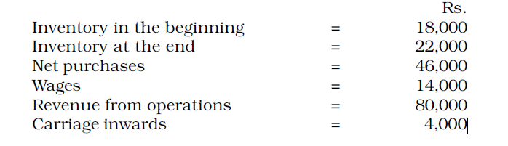
Question:
From the following information, calculate inventory turnover ratio :

Slide 51
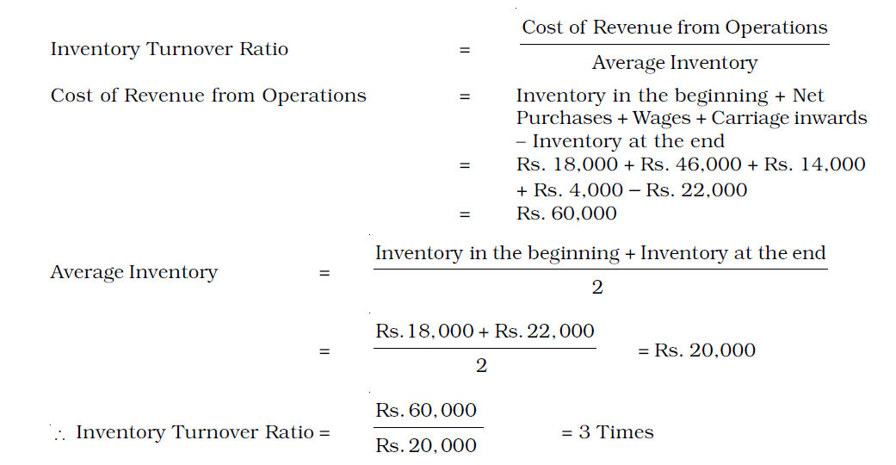
Solution:

Slide 52
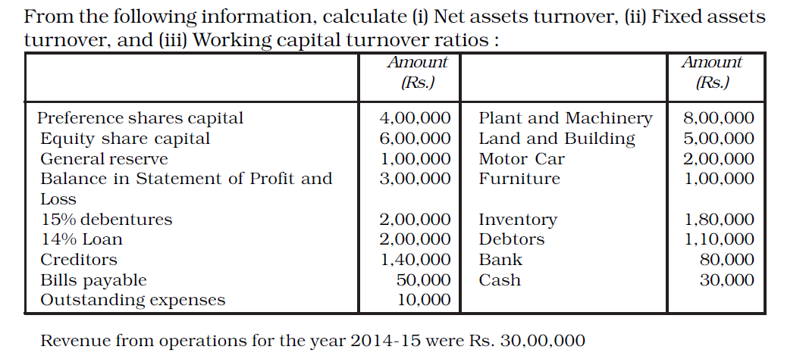
Question:

Slide 53
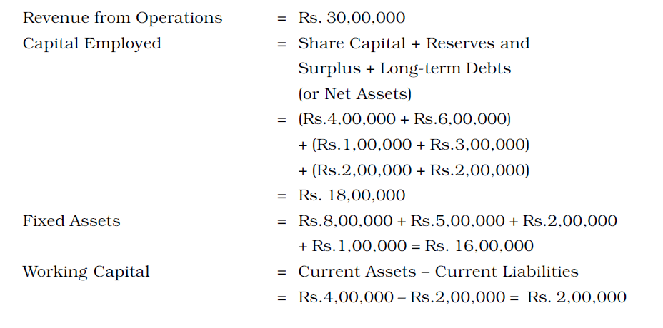
Solution:

Slide 54
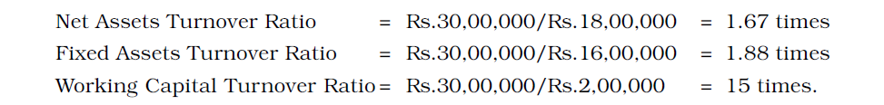
Solution: (Continued)

Slide 55
Profitability Ratios
Profitability ratios are calculated to analyze the earning capacity of the business which is the outcome of utilization of resources employed in the business.
The various ratios which are commonly used to analyze the profitability of the business are:
1. Gross profit ratio
2. Operating ratio
3. Operating profit ratio
4. Net profit ratio
5. Return on Investment (ROI) or Return on Capital Employed (ROCE)
6. Return on Net Worth (RONW)
7. Earnings per share
8. Book value per share
9. Dividend pay-out ratio
10. Price earning ratio.

Slide 56
Profitability Ratios
Gross Profit Ratio = Gross Profit/Net Revenue of Operations × 100
➔It indicates gross margin on products sold. It also indicates the margin available to cover operating expenses, non-operating expenses, etc. Change in gross profit ratio may be due to change in selling price or cost of revenue from operations or a combination of both. A low ratio may indicate unfavourable purchase and sales policy. Higher gross profit ratio is always a good sign.

Slide 57
Profitability Ratios
Operating Ratio = (Cost of Revenue from Operations + Operating Expenses)/ Net Revenue from Operations × 100
Operating expenses include office expenses, administrative expenses, selling expenses, distribution expenses, depreciation and employee benefit expenses etc. Cost of operation is determined by excluding non-operating incomes and expenses such as loss on sale of assets, interest paid, dividend received, loss by fire, speculation gain and so on.
Operating Profit Ratio = 100 – Operating Ratio
Alternatively, it is calculated as under:
Operating Profit Ratio = Operating Profit/ Revenue from Operations × 100
Where, Operating Profit = Revenue from Operations – Operating Cost
➔Operating ratio is computed to express cost of operations excluding financial charges in relation to revenue from operations. A corollary of it is ‘Operating Profit Ratio’. It helps to analyse the performance of business and throws light on the operational efficiency of the business. It is very useful for inter-firm as well as intra-firm comparisons. Lower operating ratio is a very healthy sign.

Slide 58
Question:
Given the following information:
Revenue from Operations Rs. 3,40,000
Cost of Revenue from Operations Rs. 1,20,000
Selling expenses Rs. 80,000
Administrative Expenses Rs. 40,000
Calculate Gross profit ratio and Operating ratio.

Slide 59
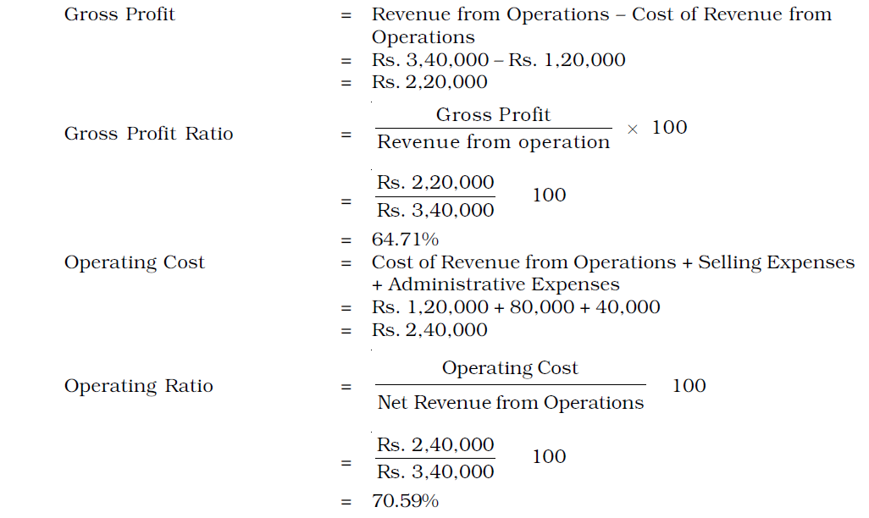
Solution:

Slide 60
Profitability Ratios
Net Profit Ratio = Net profit/Revenue from Operations × 100
➔It measures the margin of profitability on sales throughout the year and is the main indicator for measuring the efficiency of the operation as well as gauging the business’s ability to face various pressures.
Return on Investment (or Capital Employed) = Profit before Interest and Tax/ Capital Employed × 100
➔This ratio measures whether or not a company is generating adequate profits in relation to the funds invested and is a key indicator of investment performance.
Return on Shareholders’ Fund = Profit after Tax/ Shareholders' Funds × 100
➔It indicates whether or not a company is generating adequate profits for shareholders.

Slide 61
Profitability Ratios
EPS = Profit available for equity shareholders/Number of Equity Shares
Where,
Profit available for equity shareholders = Profit after Tax – Dividend on Preference Shares.
➔This ratio is very important from equity shareholders point of view and also for the share price in the stock market. This also helps comparison with other to ascertain its reasonableness and capacity to pay dividend.
Book Value per share = Equity shareholders funds/No. of Equity Shares
➔Equity shareholder fund refers to Shareholders’ Funds – Preference Share Capital. This ratio is again very important from equity shareholders point of view as it gives an idea about the value of their holding and affects market price of the shares.

Slide 62

Profitability Ratios
Dividend Payout Ratio
➔This reflects company’s dividend policy and growth in owner’s equity.
P/E Ratio = Market Price of a share/earnings per share
➔it judges the market reaction to the earning potential of a company, it should be on the higher side. P/E Ratio vary from industy to industry and company to company in the same industry depending upon investors perception of their future.

Slide 63
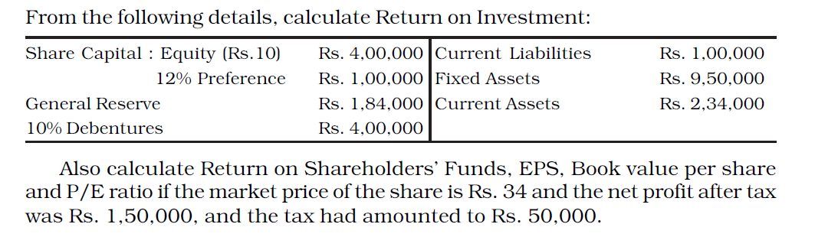
Question:

Slide 64
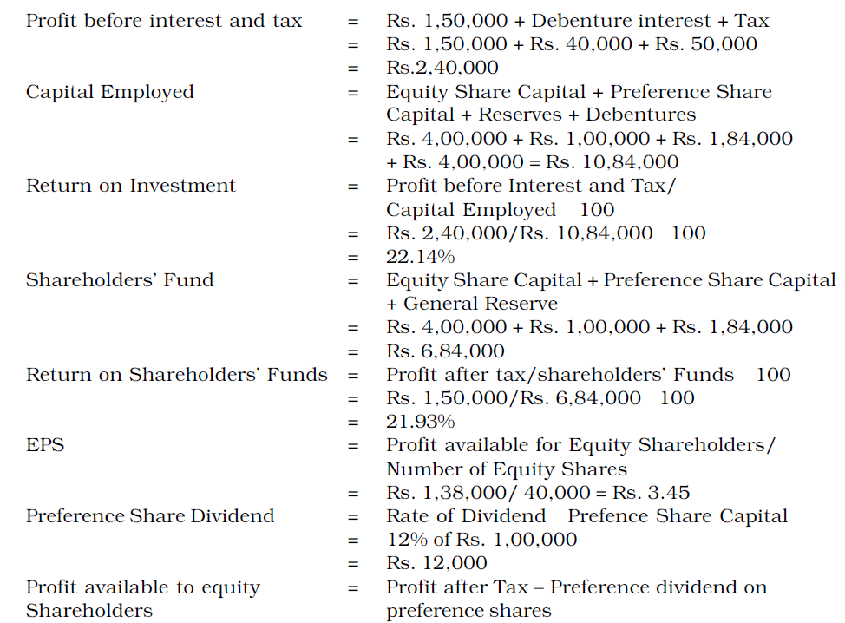
Solution:

Slide 65
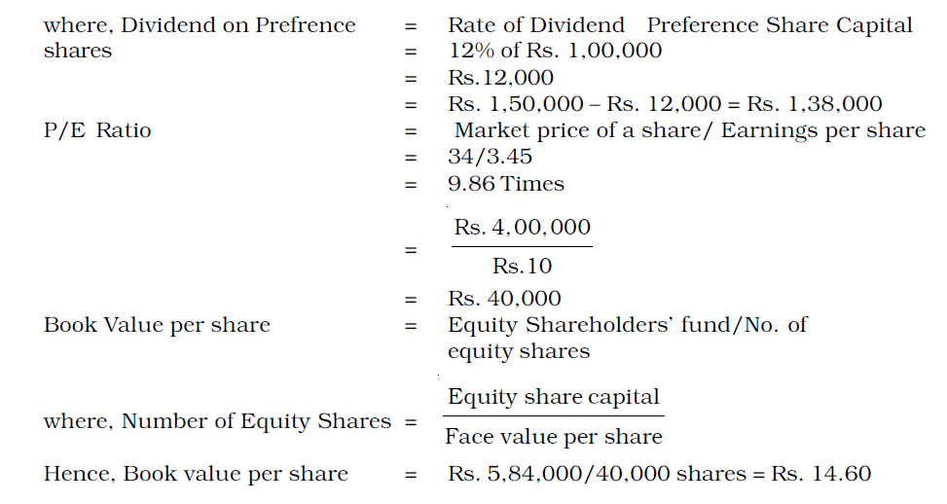
Solution:

Slide 66
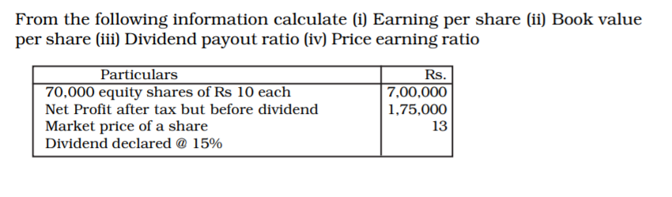
Question:

Slide 67
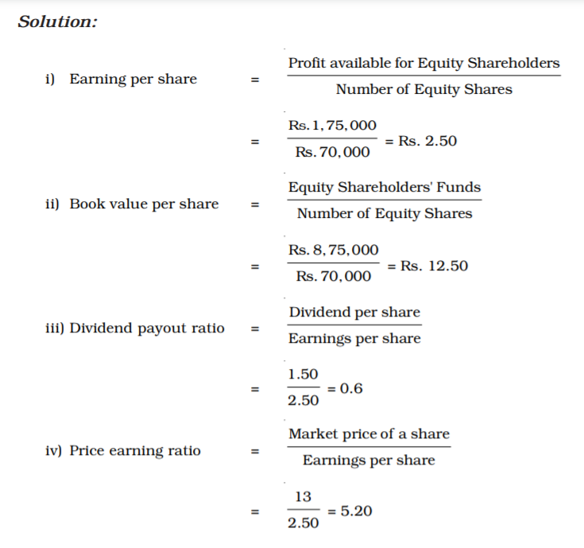

Slide 68








Slide 69
God Bless You!

